Slide 1
Chapter 9.5
Euler and Hamilton Paths
Slides by Gene Boggess
Computer Science Department
Mississippi State University
These class notes are based on material from our textbook, Discrete Mathematics and Its Applications, 6th ed., by Kenneth H. Rosen, published by McGraw Hill, Boston, MA, 2006.

Slide 2
Euler Paths and Circuits
The Seven bridges of Königsberg
C
c
D
A
a
d
B
b

Slide 3
Euler Paths and Circuits
An Euler path is a path using every edge of the graph G exactly once.
An Euler circuit is an Euler path that returns to its start.
C
Does this graph have an Euler circuit?
A
D
No.
B

Slide 4
Necessary and Sufficient Conditions
How about multigraphs?
A connected multigraph has a Euler circuit iff each of its vertices has an even degree.
A connected multigraph has a Euler path but not an Euler circuit iff it has exactly two vertices of odd degree.

Slide 5
Example
Which of the following graphs has an Euler circuit?
a
b
a
b
a
b
e
e
d
c
d
c
c
d
e
yes no no
(a, e, c, d, e, b, a)

Slide 6
Example
Which of the following graphs has an Euler path?
a
b
a
b
a
b
e
e
d
c
d
c
c
d
e
yes no yes
(a, e, c, d, e, b, a ) (a, c, d, e, b, d, a, b)

Slide 7
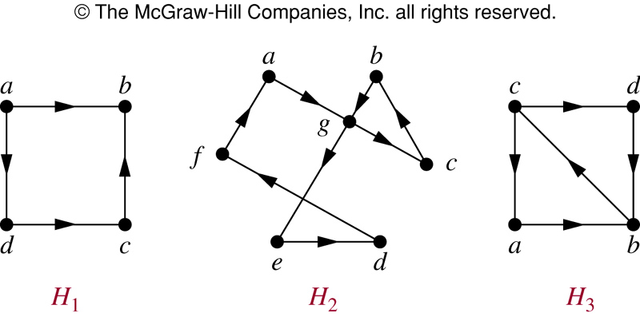
Euler Circuit in Directed Graphs
NO (a, g, c, b, g, e, d, f, a) NO

Slide 8
Euler Path in Directed Graphs
NO (a, g, c, b, g, e, d, f, a) (c, a, b, c, d, b)

Slide 9
Hamilton Paths and Circuits
A Hamilton path in a graph G is a path which visits every vertex in G exactly once.
A Hamilton circuit is a Hamilton path that returns to its start.

Slide 10
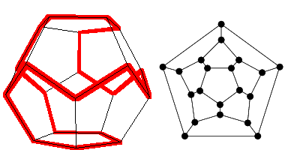
Hamilton Circuits
Dodecahedron puzzle and it equivalent graph
Is there a circuit in this graph that passes through each vertex exactly once?

Slide 11
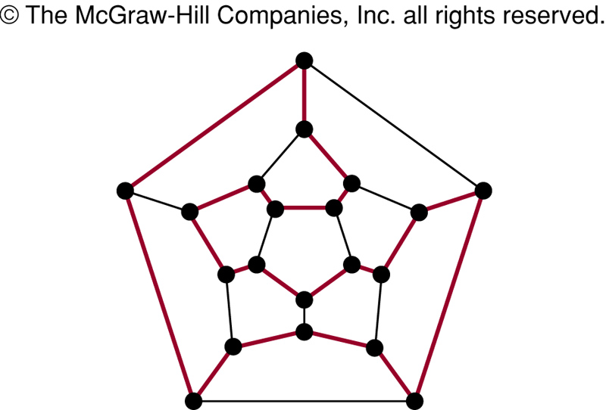
Hamilton Circuits
Yes; this is a circuit that passes through each vertex exactly once.

Slide 12
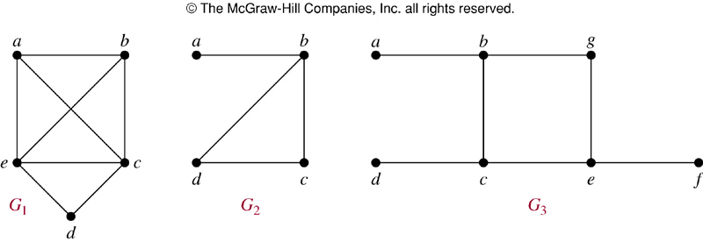
Finding Hamilton Circuits
Which of these three figures has a Hamilton circuit? Of, if no Hamilton circuit, a Hamilton path?

Slide 13
Finding Hamilton Circuits
G₁ has a Hamilton circuit: a, b, c, d, e, a
G₂ does not have a Hamilton circuit, but does have a Hamilton path: a, b, c, d
G₃ has neither.

Slide 14
Finding Hamilton Circuits
Unlike the Euler circuit problem, finding Hamilton circuits is hard.
There is no simple set of necessary and sufficient conditions, and no simple algorithm.

Slide 15
Properties to look for ...
No vertex of degree 1
If a node has degree 2, then both edges incident to it must be in any Hamilton circuit.
No smaller circuits contained in any Hamilton circuit (the start/endpoint of any smaller circuit would have to be visited twice).

Slide 16
A Sufficient Condition
Let G be a connected simple graph with n vertices with n ≥ 3.
If the degree of each vertex is ≥ n/2,
then G has a Hamilton circuit.

Slide 17
Travelling Salesman Problem
A Hamilton circuit or path may be used to solve practical problems that require visiting “vertices”, such as:
road intersections
pipeline crossings
communication network nodes
A classic example is the Travelling Salesman Problem – finding a Hamilton circuit in a complete graph such that the total weight of its edges is minimal.

Slide 18
Summary
Property | Euler | Hamilton
Repeated visits to a given node allowed? | Yes | No
Repeated traversals of a given edge allowed? | No | No
Omitted nodes allowed? | No | No
Omitted edges allowed? | No | Yes

